Slide 1


Fundamental of Mobile Development Quiz project in dart g3 team8: pov veasna & rin pichphyrom
CADT-Y3-T1
3/11/2024

Slide 2
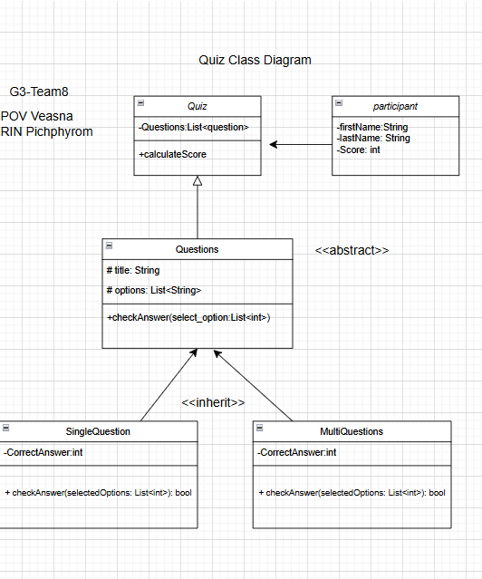
Class diagram
The purpose of this class diagram is to illustrate the design and structure of a quiz application.
This system is built to manage quizzes, single & multiple questions, and participants, also score calculation.

Slide 3
Code & demo
https://github.com/veasnapovsr/Mobile_Development_pt1/tree/main/W2_Micro%20Project

Slide 4
Thank you

